Slide 1
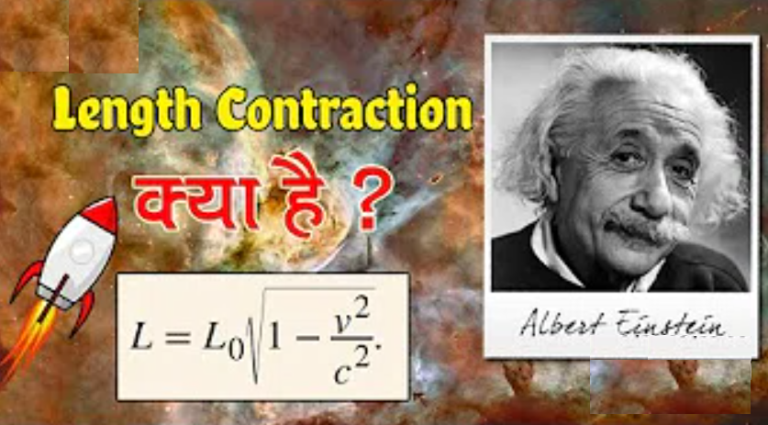
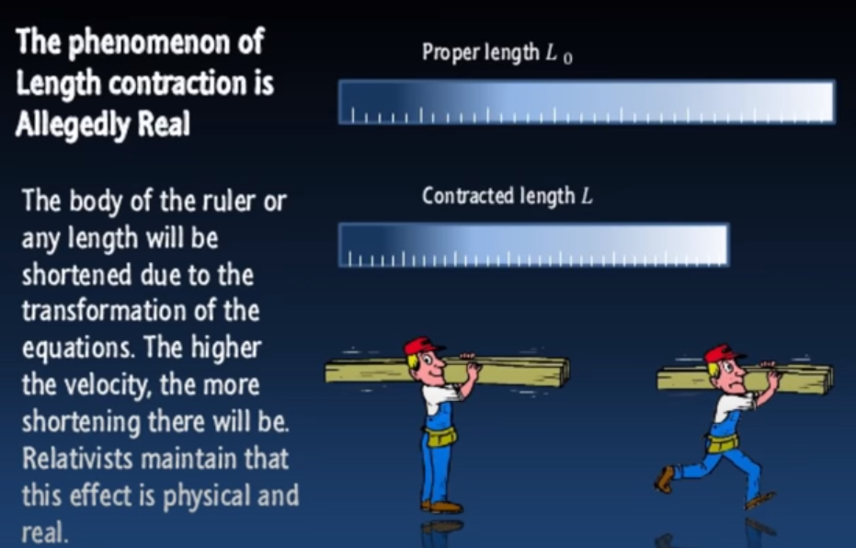
Length contraction:-

Slide 2
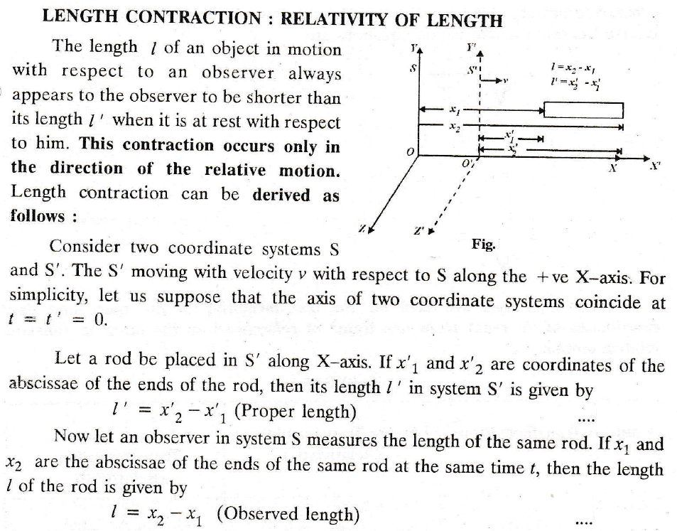

Slide 3
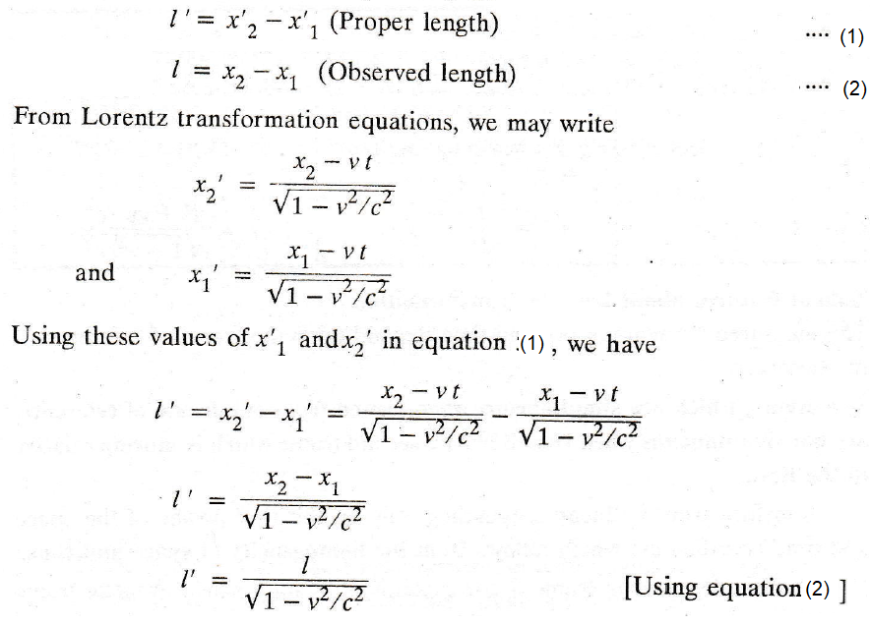
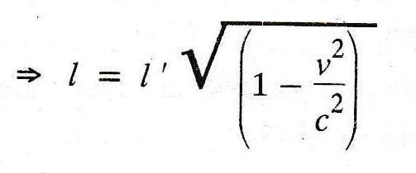

Slide 4
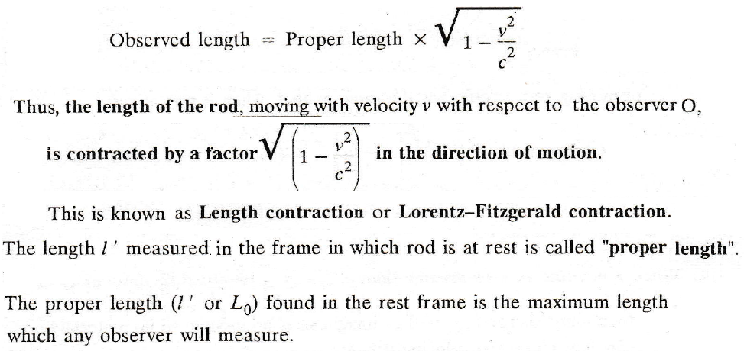

Slide 5

OR L = L_{o}√(1 – v²/c²)
Physical Significance:-
(a) when v << c, then v²/c² << 1, l = l ‘ , (L= Lo)
i.e., the Observed length (L or l ) according to observer “O” is the same as that when it is at rest.
(b) when v is comparable to c, √(1 – v²/c²) < 1 and in this case l < l’ (L< Lo) i.e., the apparent length L or L of a body in a frame S relative to which the rod is moving with uniform velocity v will be less than its proper length L_{o} or L’ by the factor √(1 – v²/c²). This contraction of length of a body along the motion is called Lorentz – Fitzgerald contraction.
(c) when v ≥ c, v²/c² ≥ 1, so that l = 0 (L=0)or imaginary i.e., That is not possible. This implies that no material body can have the velocity equal to or greater than the velocity of the light.
If V=0.5C, So √(1 – v²/c²) = √(1 – [0.5c]²/c²)= √(1 – [0.5]² = √0.75= 0.866
So L = L_{o} (0.866)=> if L_{o} =10m, so L =8.66m

Slide 6
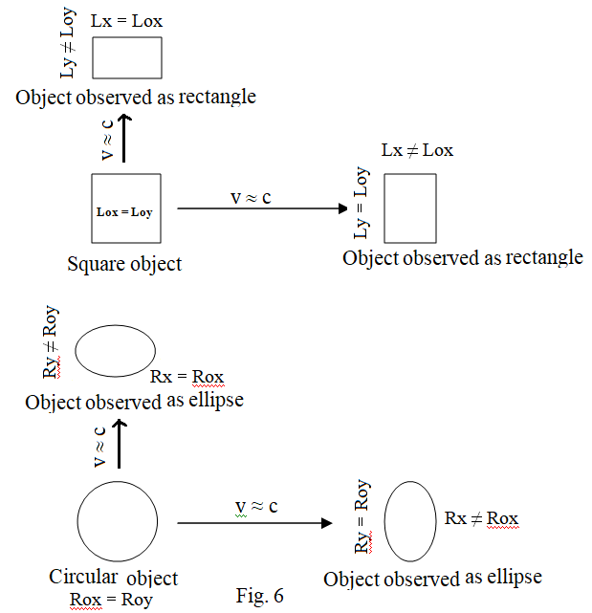
Contraction of length of a body along the motion
If the length is measured in a direction normal to the direction of motion no contraction is observed as y’ = y and z’ = z in the Lorentz transformations.
Thus a moving square will appear as a rectangle with shorter side along the direction of motion and
a circle will appear as an ellipse with its minor axis along the direction of motion.

Slide 7
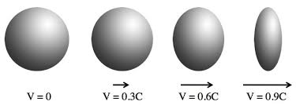
Length Contraction Depends on the velocity of Object
Reference:-Video Lecture on Length contraction:- https://www.youtube.com/watch?v=p6hhFkSXpRY

Slide 8


You all have to watch “interstellar movie” before attending my next lecture
or
https://www.youtube.com/watch?v=fSzDm19LVIg

